Slide 1
Hotel Rating Classification
Team 3 (P281)

Slide 2

Business Problem:
what are the attributes that travelers are considering while selecting a hotel?
Objective:
The Major Objective for building this project was to help the manager of the hotel to understand what amenities will attract the travelers/tourist for considering their hotel.
For this , the hotel manager uses the feedback(Positive & negative) and ratings from various sources their previous customers .so , with the help of that data we need to find which attributes that travelers are considering.

Slide 3
The dataset used in this project is hotel reviews.csv that contains 20491 instances of reviews with 2 features like review and rating.
The python libraries and packages we’ll use in this project are namely:
NumPy
Pandas
Seaborn
Scipy
We’ll use the specifications like review and rating helps us to classify the attributes that customer is looking for, while booking a hotel while travelling.

Slide 4
Exploratory Data Analysis (EDA)

Slide 5
Data set details
This dataset includes descriptions of samples corresponding to 2 features reviews & ratings from dataset the rating will be given between 1-5
1- Poor,2-Unsatistifactory,3-Average,4-Good,5-Excellent and reviews is about the experience they faced while staying in the hotel .These are collected from the various sources where the customers give the feedback about the hotel using this we need to help the manager of the hotel to arrange the hotel requirements accordingly.

Slide 6
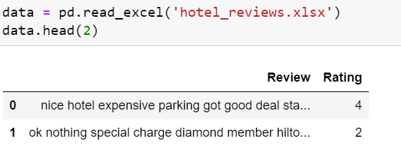

Slide 7
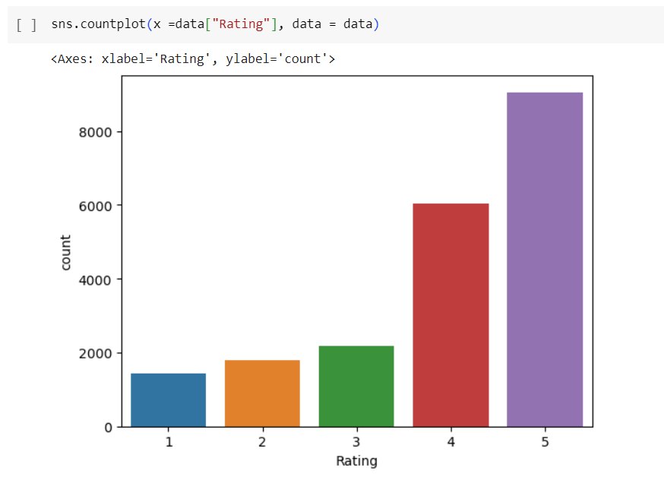
Exploratory Data Analysis (EDA)
They EDA of Ratings .

Slide 8
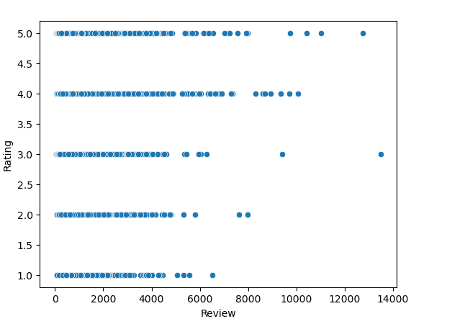
Length of Reviews

Slide 9
Steps followed:
Tried converting all the words to lower case since python treats lower- and upper-case letters differently.
Removed stop words and converted the words to rootwords(stemming)
Removed punctuations and brackets
Created sentiment column tagged as rating above 4 as positive and below 4 as negative

Slide 10
Sentiment Intensity Analyzer
Vader is a lexicon and rule based sentiment analysis tool specifically calibrated to sentiments most commonly expressed on social media platforms. When calculating a polarity score Vader outputs four metrics: compound, negative, neutral and positive. The compound score calculates the sum of all lexicon ratings which is normalized between -1 (most negative) and +1 (most positive).

Slide 11
Model Building
Model building using logistic Regression and Naïve bayes
Accuracy levels are 0.89 and 0.76 respectively for the Logistic and SVM
Oversampling technique for minority class by using SMOTE and did model building and the accuracy improved to 0.91 and 0.88 respectively for logistic Regression and Naïve Bayes

Slide 12
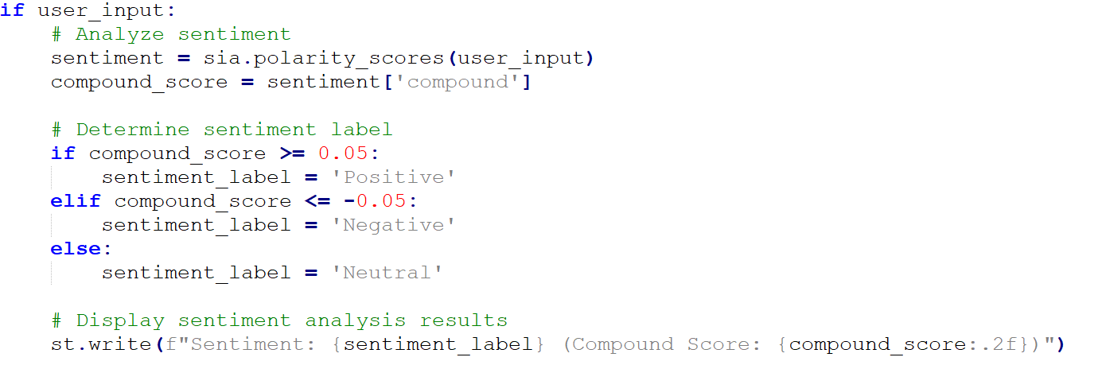
Deployment

Slide 13
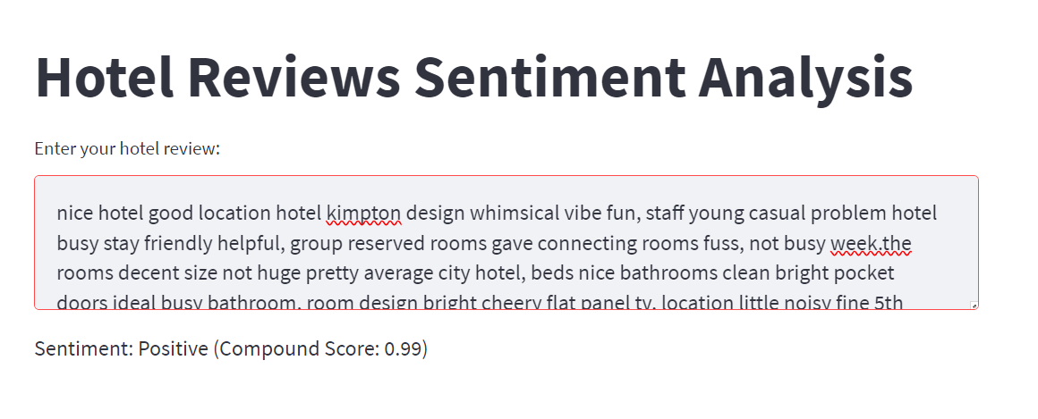

Slide 14
Thank you

